Slide 1
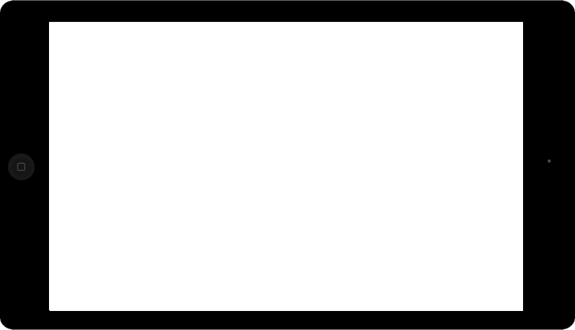
eduAV
Touch to Build Your Personalised eduAv
Your Digital Classroom Platform

Slide 2

Move! Rotate! Resize!
To Build Your eduAv

Slide 3




Skin Tone Choices
1 2
3 4

Slide 4






Eye Colour Choices
Blue
Green
Brown

Slide 5



Nose Choices
Small
Medium
Large

Slide 6



Mouth Choices
Smile
Grin
Smirk

Slide 7
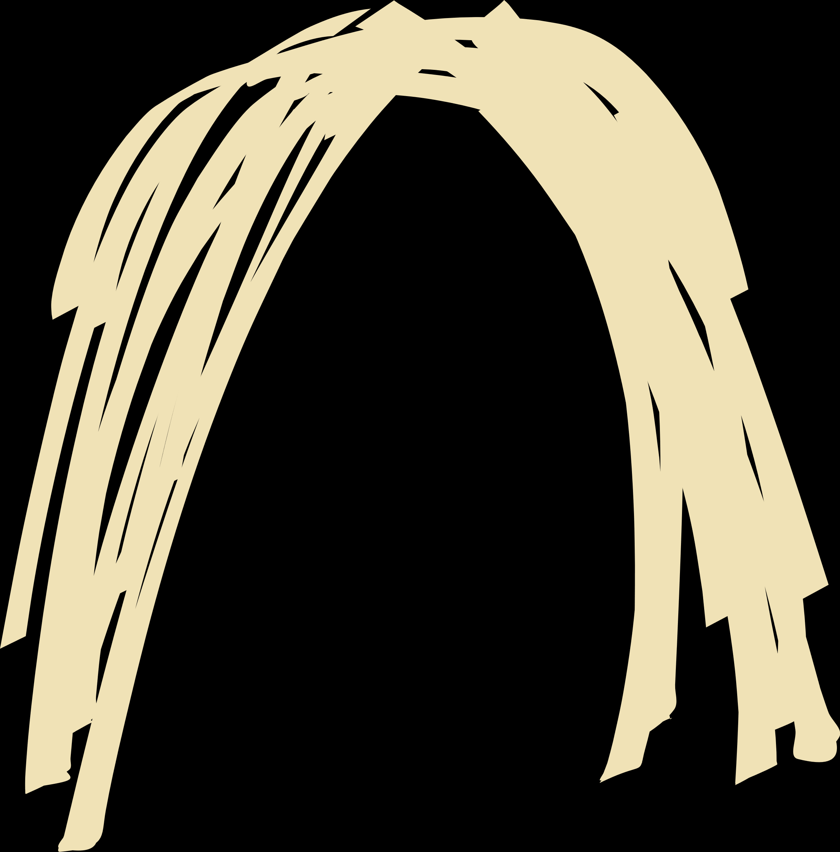





Hair Choices
Long
Short
Blonde
Brown
Black

